Slide 1
Citation Prediction Bioinformatics
Darpan Jhawar // Luke Davis // Logan Hornbuckle // Mouna Kalidindi // Steve Stamey

Slide 2
Phase 2 Progress Breakdown
Extracted and Organized data (using python)
Performed graphical analysis on data
Acquired info regarding “variables of interest” for predicting citations

Slide 3
Phase 2 Division of Labor
Each member wrangled a different subset of our data
Darpan - Eid, № of citations, Language, Para, Title
Logan - Subject area, author keywords
Mouna - Publication details (year, name, type)
Steve - Affiliations details (ID, country , name)
Luke - № of authors, № of affiliations, author names

Slide 4
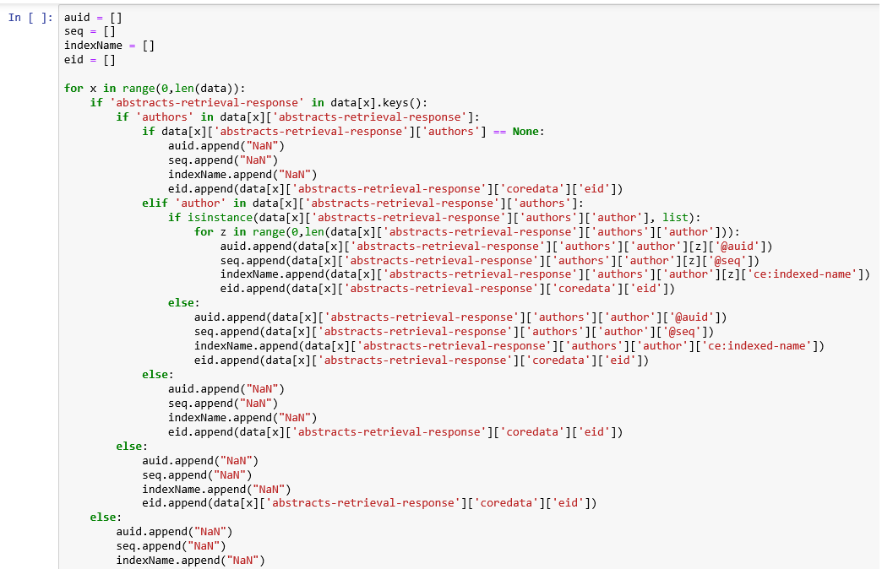
Luke
№ of authors
№ of affiliations
Data Extraction Code
What is the distribution of this data?
How might this data help us predict citations?

Slide 5
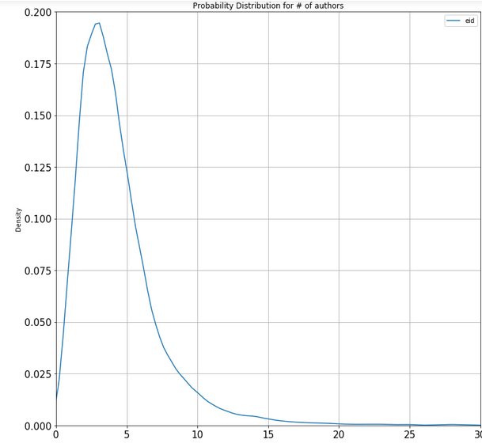
Probability Distribution for # of authors
Most common: 3 authors
Median: 4 authors
Mean: 4.40
S.d.: 3.68
68% of data has somewhere between 1 and 8.08 authors

Slide 6
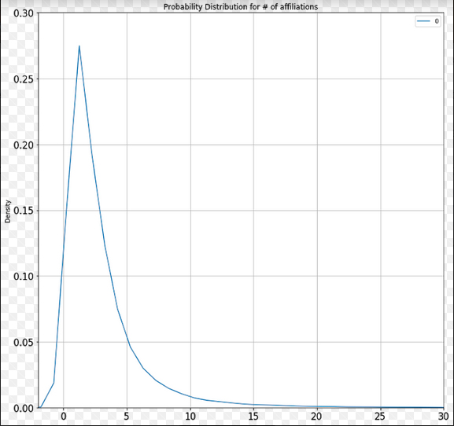
Probability Distribution for # of affiliations
Most common: 1 affiliation (by far)
Median: 2 affiliations
Mean: 2.95
S.d.: 5.40
68% of data has somewhere between 1 and 8.35 affiliations

Slide 7
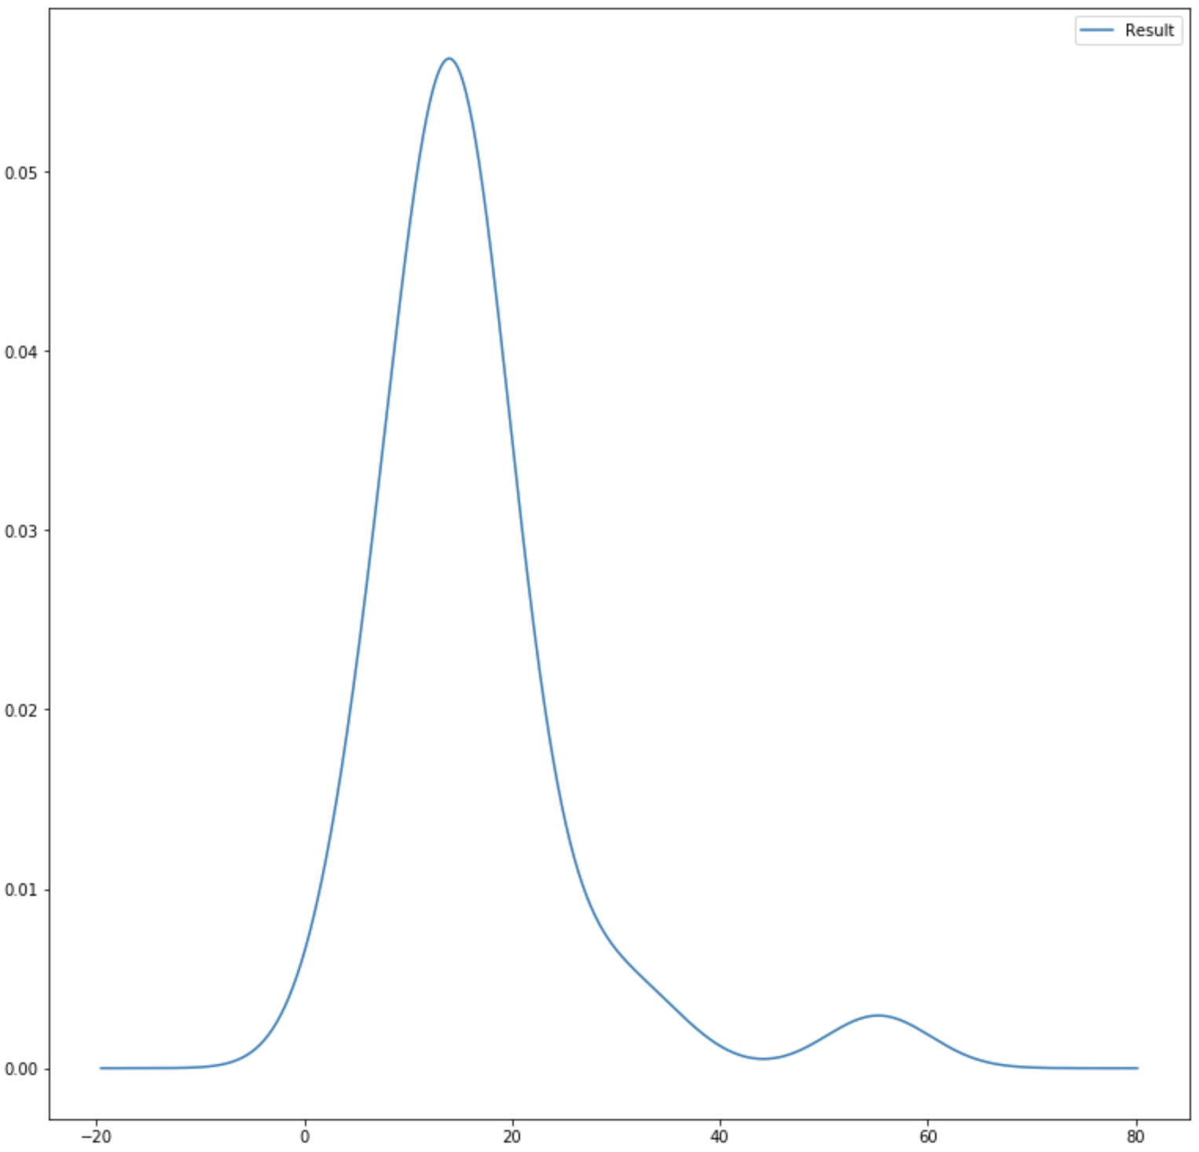
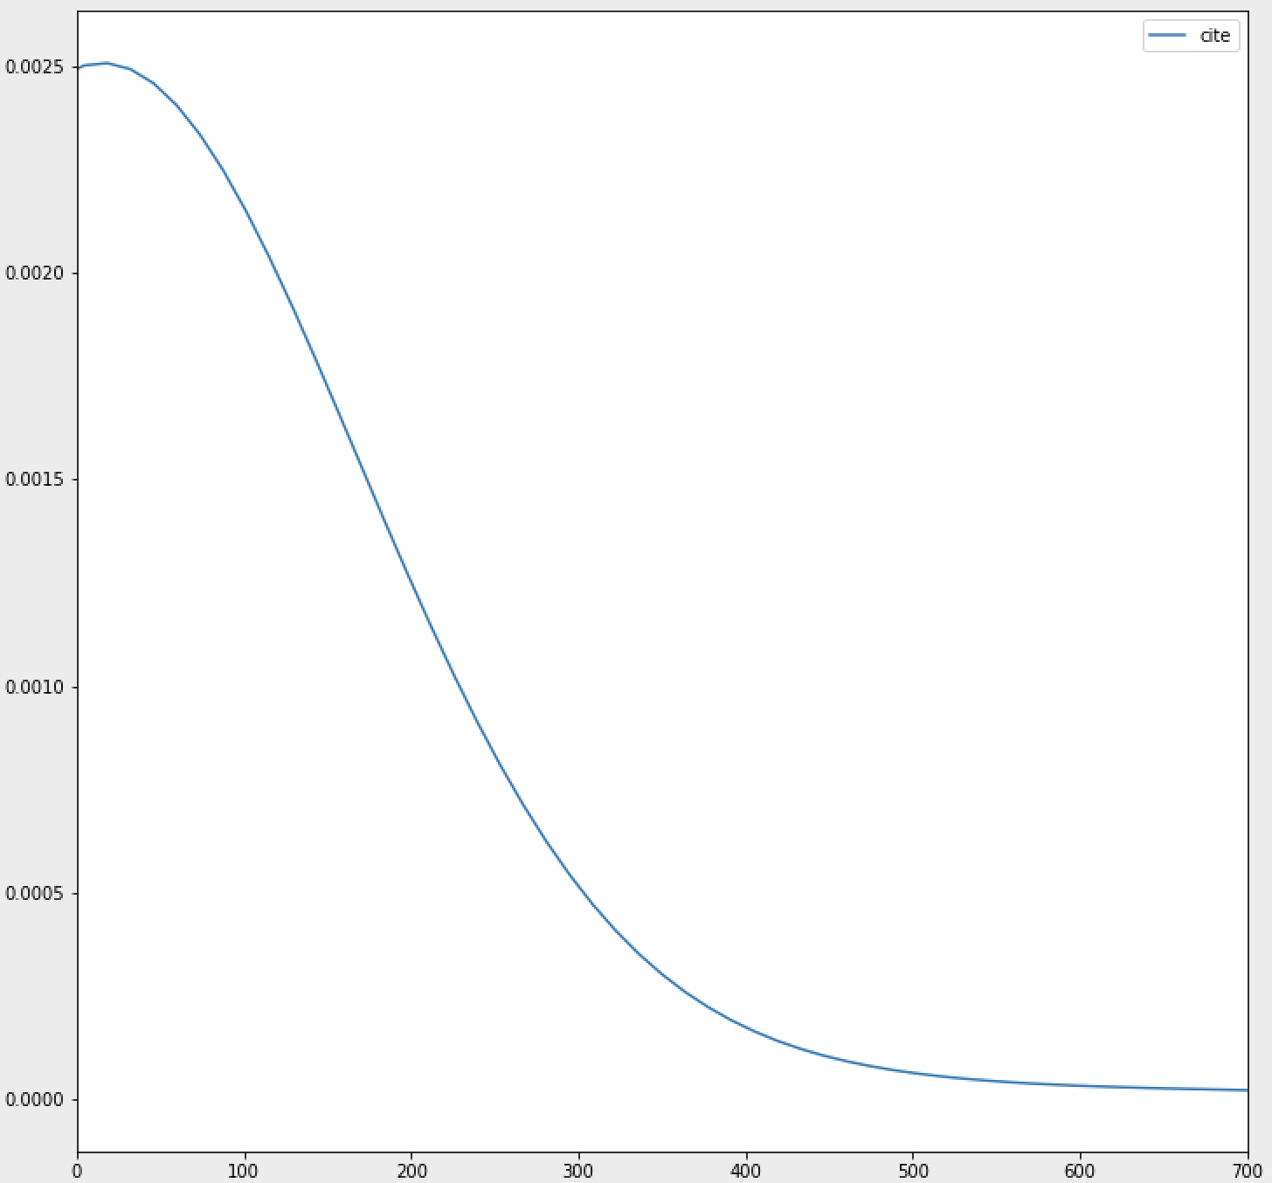
Density Curves For Number of Citations
Average Citations per Paper (Grouped by Subject Area)
Total Citations per Paper

Slide 8
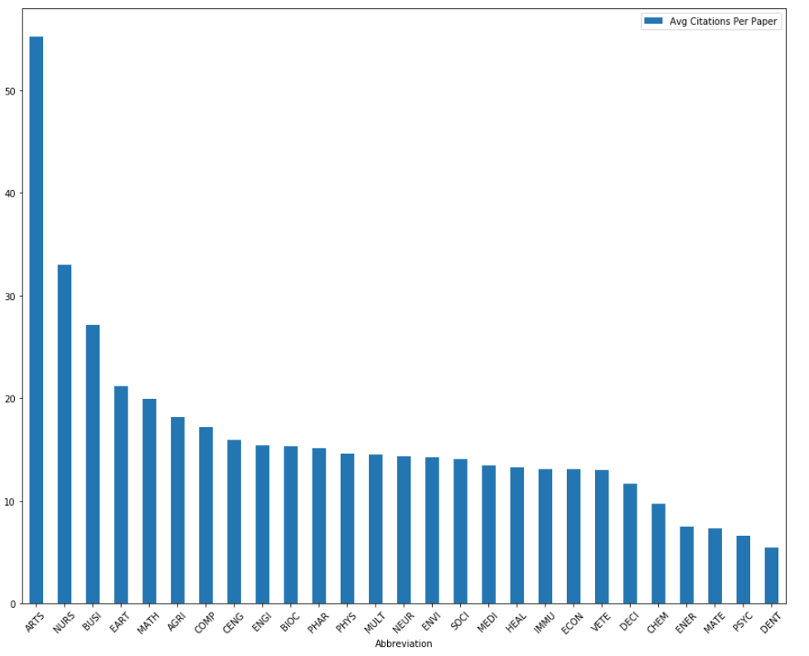
How do the average number of citations differ with each field of study?
What conclusions can be drawn?
Average # Citations per Paper (1986-2017)

Slide 9
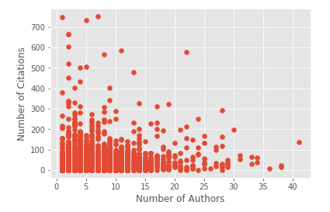
Correlation
Does Number of authors working on a paper help predicting citation?
Correlation for year 2010-2011 is 0.04

Slide 10
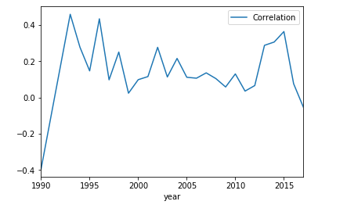
Correlation over different time periods.

Slide 11
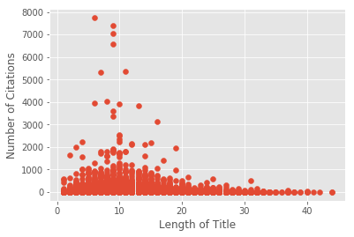
Correlation between Number of Citations and Length of Title

Slide 12
